Slide 1

ICT504 IT Strategy & Leadership Week 1 Introduction Lecturer: Dr. Farshid Keivanian

Slide 2
Lecture Outline
Unit Outline Overview
Unit objective
The role of ICT in business world.
Advancement of technology in business.
The importance of strategic and leadership change.

Slide 3
Unit Overview
ICT504 focuses on advanced strategic IT planning and leadership. You will:
Develop IT strategies to solve organisational problems
Build leadership capabilities through roleplay, reflection, and collaborative planning
Understand business-IT alignment, ethics, governance, and global strategy
Engage with real-world scenarios like Qantas leadership changes and strategic failures

Slide 4
Unit Overview
ASSESSMENT PLAN (Total 100%)
Quiz (Week 3 - 10%)
Multiple Choice & True/False to test theory
Tip: Focus on strategic alignment, IT-business value, leadership models
Mid-Term Short Answer Test (Week 6 - 30%)
Theory + scenario-based calculations
Tip: Practice using frameworks (e.g., SWOT, Porter's 5 Forces) in leadership contexts

Slide 5
3. Reflective Journal: Leadership Challenges (Week 9 - 20%)
Analyse leadership dilemmas using real cases (e.g., Qantas CEO)
Tip: Link theory (e.g., resilience, ethics) with personal insights
4. Strategic Plan Report + Presentation (Week 12 - 40%)
Write a board-ready strategic plan for an IT leadership case
Tip: Use frameworks like Balanced Scorecard, PESTLE, and IT Portfolio Management

Slide 6
SUCCESS TIPS
Understand Assessment Rubrics: Each rubric outlines how to achieve full marks
Use APA Referencing: Include in-text citations and a complete reference list

Slide 7
Stay Organised:
Use Word's built-in Table of Contents
Submit Turnitin drafts early for feedback
Link Theory + Practice:
Refer to Rothaermel's Strategic Management book
Use industry articles (e.g., Guardian Qantas article) for evidence

Slide 8
WHAT TO AVOID
Plagiarism & AI overuse: Turnitin and AI detection will be used. Write in your own words.
Late Submissions: Avoid penalties by keeping deadlines in calendar alerts
Ignoring Feedback: Revisit Studiosity comments and in-class feedback before final submission
Shallow Research: Avoid just Googling answers. Use scholarly sources and unit readings.

Slide 9
TOOLS & RESOURCES
Studiosity: Pre-submission writing feedback
Turnitin Draft Coach: Self-check originality and grammar
Strategic Textbooks:
Rothaermel (2021) Strategic Management
Recommended journal articles from Moodle

Slide 10
Participation & Leadership
Be active in class discussions and role plays
Ask questions and clarify early
Treat assignments like professional reports for a board or leadership team

Slide 11
Final Advice: This unit simulates real-world strategic leadership. Show professionalism, depth of thinking, and application of frameworks. Think like a future CIO or IT leader.

Slide 12
List of Topics (Direct from Unit Outline)
TOPICS
Develop strategic IT plans to solve organisational problems.
Lead complex IT environments with confidence, resilience, and capability.
Build strategic leadership capabilities through role play.
Collaborate with peers to work effectively towards collective outcomes.
Write new business practices with consideration to ethical issues.
Produce governance documents that communicate strategic plans and information effectively for the board and senior IT executives.

Slide 13
Subject Objectives (Direct from Unit Outline)
Objectives
Provide students with advance knowledge of strategic IT planning.
Explore complexity of strategic leadership.
Study available tools to enable effective work in the challenging world of IT.
Understanding the importance of strategic thinking in leadership development.
Understanding the industry dynamic and strategic responses to competitive challenges.
Improvement of the organisational performances.

Slide 14
Role of ICT in Business World
ICT (Information & Communication Technology) helps businesses grow, connect, and compete.
Australian businesses like Woolworths use ICT for tracking inventory and improving customer service.
In the past, many companies didn’t plan ICT well — now they deal with “legacy systems” that are hard to change.
Learning from these mistakes is key to doing better in the future.

Slide 15
Role of ICT in Business World
Example: Woolworths uses ICT to automate self-checkouts and manage stock levels through real-time data.

Slide 16
Role of ICT in Business World
Example: Woolworths uses ICT to automate self-checkouts and manage stock levels through real-time data.

Slide 17
Technology Factors
Technology Factors in Business
What tech a business uses matters: fast computers, internet speed, cloud services, etc.
You need skilled people to build and use this tech.
Change can be hard — that’s why “Change Management” is important.
People also expect faster and more reliable service (e.g. using MyGov in Australia).

Slide 18
Technology Factors
Example: MyGov app helps Australians manage taxes, healthcare, and Centrelink online — but only works well with strong digital infrastructure.

Slide 19
Strategic & Leadership Change
Leadership in a Tech World
Good leadership is needed to guide tech changes.
Leaders must think strategically, not just fix problems.
We need leaders who can communicate, adapt, and make smart tech decisions.
Role-play helps build leadership skills.

Slide 20
Strategic & Leadership Change
Example: Telstra leaders moved call centers online — requiring staff training and leadership to make it successful.

Slide 21
Technological Impact
How Technology Changes Business
Businesses evolve when tech changes — some industries are hit harder.
Retail changed a lot — now we shop online (e.g., Amazon, Kmart).
New ideas like CRM (Customer Relationship Management) help companies stay close to their customers.
Managing the change is just as important as the tech.

Slide 22
Technological Impact
Example: Kmart uses CRM systems to send personalised offers via email or app notifications.

Slide 23
New Business Models
New Business Models from New Tech
Business is now about data, people, process, and infrastructure.
IoT (Internet of Things) helps track devices and improve efficiency (e.g., smart fridges, traffic lights).
Data is the new currency — even government departments rely on it.

Slide 24
New Business Models
Example: NSW Transport uses IoT to track buses in real-time, improving commuter experience.

Slide 25
Pillars of Digitalisation
4 Pillars of Going Digital
User Experience – Apps/websites must be easy to use (e.g., Service NSW).
Digital Processes – End-to-end automation (e.g., food delivery apps).
Digital Speed – Fast rollout of new tech.
Empowering Teams – Everyone must contribute, not just IT.

Slide 26
Pillars of Digitalisation
Example: Domino’s Pizza App covers all 4 pillars — order, track, deliver, feedback.

Slide 27
Digital Disruption
Digital Disruption = Big Change
Tech can break old ways of doing business.
It can confuse people, especially if not planned well.
Customers expect more privacy, better service — fast!
Businesses need new standards and goals.

Slide 28
Digital Disruption
Example: Uber disrupted taxis in Australia — changing how we travel, pay, and complain.

Slide 29
IT Advancement in Business
How IT Helps Business
Data & Automation = Faster work, fewer mistakes.
MIS (Management Info Systems) = Smarter decisions.
SIS (Strategic Info Systems) = Gain a competitive edge.

Slide 30
IT Advancement in Business
Example: Commonwealth Bank uses advanced data systems to recommend financial products in real-time.

Slide 31
Strategic Information Systems (SIS)
Why SIS Matters
SIS helps a business stand out.
It allows better services, faster processes, and smart decisions.
Used in business process redesign, framework updates, and goal setting.

Slide 32
Strategic Information Systems (SIS)
Example: Qantas uses SIS to manage bookings, customer loyalty, and route planning.

Slide 33
Research Discussion Questions
How has technology improved your shopping or banking experience in Australia?
Why do some businesses struggle with tech adoption?
What leadership traits help drive successful IT changes?

Slide 34
Hands-On Activities
Create a mind map of how ICT is used in MyGov, Telstra, or Kmart.
Use Google Trends or Australian Bureau of Statistics to explore data on digital adoption.
Build a basic business process flow (e.g., Online Order → Delivery) using diagrams.net or Lucidchart.

Slide 35
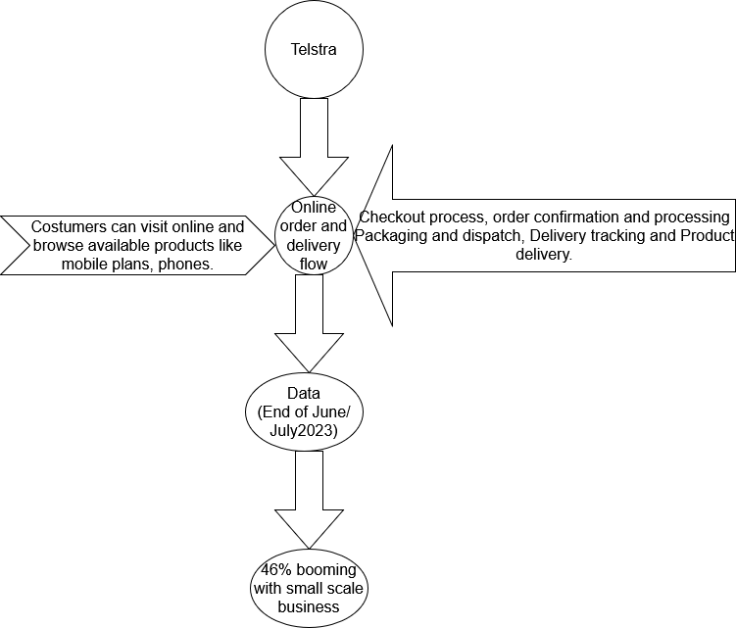
Sujan’s class activity

Slide 36
Group Presentation Ideas
Choose an Australian company (e.g., Bunnings, ATO, Optus).
Explain how they use ICT to improve service.
Discuss leadership and strategy used during tech rollouts.

Slide 37
Role-Play Debate Questions
“Digital disruption helps businesses more than it hurts them.” – Agree or disagree?
“Old systems should be kept instead of replaced.” – Take sides and debate.
“Leadership is more important than technology in business success.” – Discuss with real examples.

Slide 38
Assessment Methods (Direct from Unit Outline)
Assessment tasks | Week | Wight
1. Early intervention – Online Quiz test comprising of a variety of theoretical questions (MCQs and True/False). 500 Words equivalent. | Week 3 | 10%
2. Mid-term test comprising of a variety of theory and calculation questions (Short Answer questions). 1,500 Words equivalent. | Week 6 | 30%
3. Summative reflective journal – Leadership challenges. 1000 words equivalent. | Week 9 | 20%
4. Report and present a strategic plan for a given leadership case study. 2000 words equivalent. | Week 12 | 40%

Slide 39

Reading Materials

Slide 40
Books & Articles
D. Hofman, S. Aronow, and K. Nilles Gartner’s (2013). Supply Chain Top 25: Learning From The Industry Leaders, http://www.supplychain247.com/article/gartners_2013_supply_chain_t.op_25_learning_from_the_industry_leaders
P. Checkland and S. Holwell, Information, Systems and Information Systems: Making Sense of the Field, John Wiley & Sons, Chichester, UK, 1998.
G. L. Neilson, K.L. Martin and E. Power, ‘The secrets of successful strategy execution’, Harvard Business Review, June, 2008, 61–70.
R.Y. Wang and D.M. Strong, ‘Beyond accuracy: what data quality means to data consumers’, Journal of Management Information Systems, 12, 4, 1996, 5–34;
Kwon, N. Lee and B. Shin, ‘Data quality management, data usage experience and acquisition intention of big data analytics’, International Journal of Information Management, 34, 3, 2014, 387–394;
Y.J. Kim, R. Kishore and G.L. Sanders, ‘From DQ to EQ: understanding data quality in the context of eBusiness systems’, Communications of the ACM, 48, 10, 2005, 75–81;
S. Watts, G. Shankaranarayanan and A. Even, 2009, ‘Data quality assessment in context: A cognitive perspective’, Decision Support Systems, 48, 1, 2009, 202–211;
V.C. Storey, R.M. Dewan and M. Freimer, ‘Data quality: setting organizational priorities’, Decision Support Systems, 54, 1, 2012, 434–442;
P. Woodall, A. Borek and A.K. Parlikad, ‘Data quality assessment: The hybrid approach’, Information & Management, 50, 7, 2013, 369–382.

Slide 41
Tutorial Week 1
ICT504 IT Strategy and Leadership
Tutorial 1
Practical Section: Western Australia Public Transport
Public transport has played a major part in the history of Western Australia. The Public Transport Authority (PTA) is responsible for the following transport services:
Rail, bus and ferry services in the metropolitan area (Transperth)
Public transport services in regional centres (TransRegional)

Slide 42
Tutorial Week 1
Coach and rail passenger services to regional areas (Transwa)
School bus services
Designing, building and maintaining transport infrastructure and rollingstock and associated parts (see our Projects)
Protecting the long-term viability of the State’s freight rail corridor and infrastructure.

Slide 43
Tutorial
Since 2010, the State’s three key transport agencies - the Public Transport Authority, the Department of Transport and Main Roads - have worked together as the Transport Portfolio to coordinate a smarter, integrated and optimised transport network for WA.
Source: https://www.pta.wa.gov.au/about-us/our-role
Practical Work:
Discuss the advancement of technology in WA public transport.
Explain the importance of strategic and leadership in Western Australia Public Transport.

